Slide 1
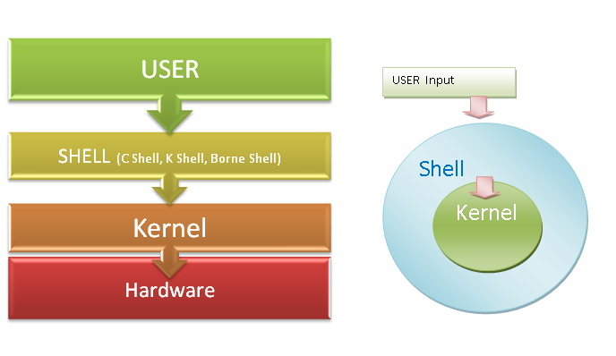
Linux System Organisation

Slide 2
SHELL
Also known as Command Interpreter
Acts as a mediator
Interprets the commands and conveys them to the kernel which ultimately executes them

Slide 3
Kernel
Manages files
Carries out all the data transfer between the file system and the hardware
Manages memory
Scheduling of various programs running in memory or allocation of CPU time to all running programs
Also handles any interrupts issued

Slide 4
For UNIX OS
Kernel Program is usually stored in a file called 'unix'
Shell Program is in a file called 'sh'
For LINUX OS
Kernel Program is usually stored in a file called 'linux'
Shell Program is in a file called 'sh/bash'

Slide 5
Types OF Shells
Bourne Shell
C Shell
Korn Shell

Slide 6
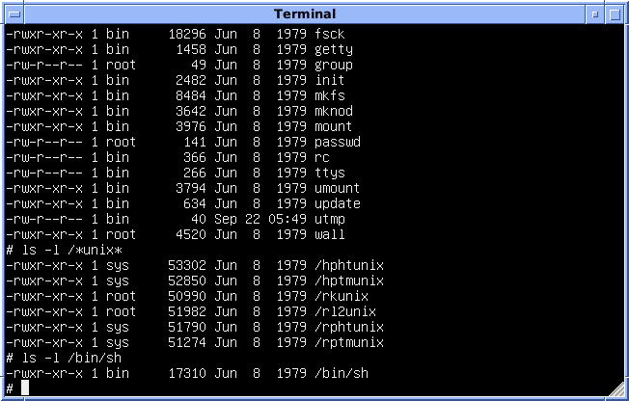
Bourne Shell

Slide 7

Bourne Shell
Developed by Steve Bourne
Command Prompt is $ in C Shell
Most popular
Bundled with every Unix system

Slide 8
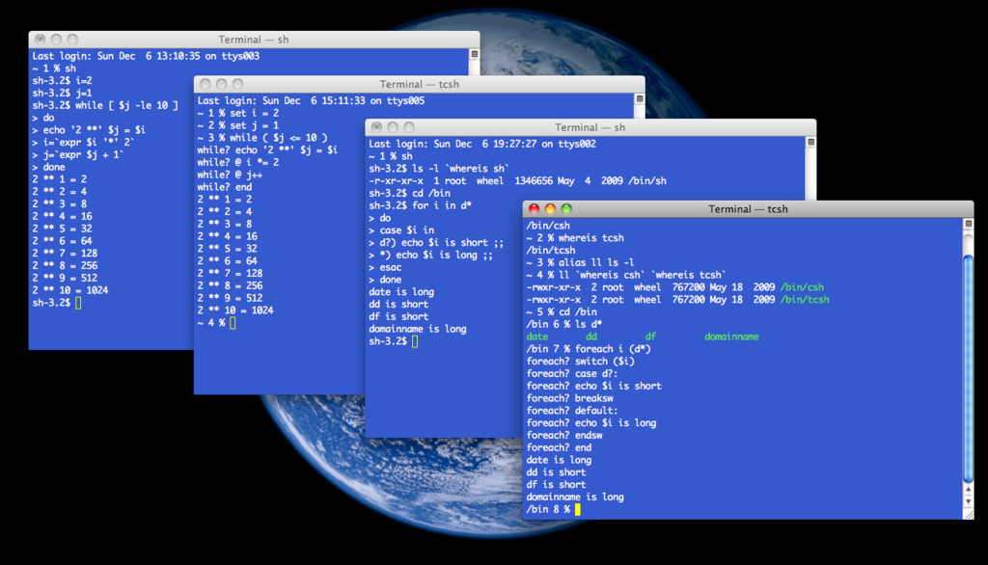
C Shell

Slide 9
C Shell
Developed by Bill Joy
Command Prompt is % in C Shell
Two advantages over Bourne:
Allows aliasing of commands
Command history feature

Slide 10
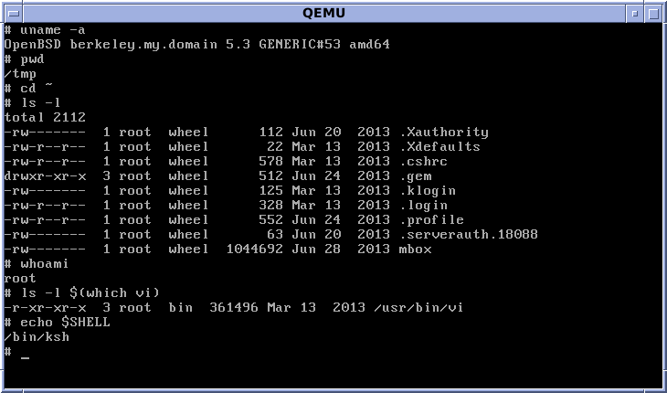
Korn Shell

Slide 11
Korn Shell
Developed by David Korn
Offers a lot more capabilities and is decidedly more efficient than others..

